Slide 1

Perceptions and Impacts of Local Education within the ICT Field
Jade Vella
Mr. Frankie Inguanez
Institute of Information & Communication Technology
MCAST, Paola, Malta
Notes:
My dissertation is titled the perceptions and impacts of local education within the ICT field
Through this presentation I will be going through the main points that my research has uncovered

Slide 2
Problem Definition
The primary problem is to determine the educational path that maximizes the potential in different aspects, including a smooth transition to full-time employment, and assesses the difference different educational paths make on a long-term basis. Therefore, assessing the benefits and impacts of such an approach to education is essential.
Notes:
The main problems my research focused to tackle are
to analyse different educational paths, therefore traditional education and vocational education
Assess the transition between being full-time student to full-time job
And also to see if there any significant difference among individuals with different educational backgrounds over time
It is also important to mention that in Malta traditional education is predominantly invoked by the university of Malta while vocational education is invoked by MCAST

Slide 3
Research Questions & Hypothesis
What is the student opinion before and after taking each educational path?
What is the perception of ICT organisations on the two different educational styles?
How does the difference in impact of the educational styles ware off?
Is there a correlation between an educational path and job or entrepreneurial opportunities?
The hypothesis of this research was to primarily focus on the local perceptions
and impacts of educational styles within the local ICT sector.
Notes:
With regards to research questions as can be seen in this slide I had 4 research question and the hypothesis of this research was to primarily focus on the local perceptions
and impacts of educational styles within the local ICT sector.

Slide 4
Literature
Perceptions of the Research-Practice Gap in Management Accounting: A Comparison between Australia and Germany. [1]
Data Collection: Interviews with 19 senior representatives from Australian professional bodies and 14 representatives of German professional accounting bodies.
Common Barrier: Both countries perceive that the communication of research poses a significant barrier to bridging the research-practice gap.
Unique Barrier - Australia: Practitioner Access to Academic Research
Unique Barrier - Germany: Relevance of Research Topics
Notes:
With regards to literature, it was difficult to find similar studies which had the same approach however this research aligned to mine since it focused on comparing the research-practice gap between 2 countries, Germany and Australia. However this study focused on the accounting field.
It is also important to mention that this research's methodology opted for a qualitative approach by conducting interviews

Slide 5
Aim of Research
This study aims to shed light on any misconceptions or old perceptions which may not be in line with facts and also reveal the benefits with regards to each learning style. As to approach this a triangulation of research methods is being planned.
Notes:
This aim of this research shed light on any misconceptions or old perceptions which may not be in line with facts and also reveal the benefits with regards to each learning style.

Slide 6
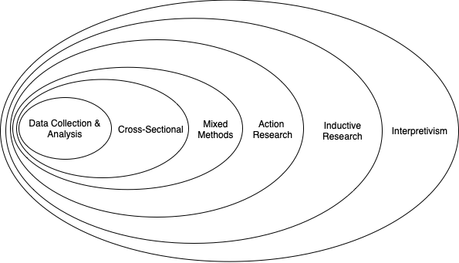
Methodology – Research Onion
Notes:
Here we can see the research onion with characteristics which my research mostly aligns to. Interpretivism……………
Interpretivism – focuses on understanding and interpreting the meanings, motivations, and subjective experiences of individuals within their social and cultural contexts
Inductive research - involves generating theories or generalizations based on specific observations or patterns observed in the data.

Slide 7
Methodology – Triangulation of view points
The Lead Researcher
Perceptions and Impacts of Local Education within the ICT Field
General Perception
Specific ICT Professional Experiences
Notes:
As for methodology I opted for a triangulation of viewpoints,
The first view point is the lead researcher’s which is mine
Second - General perspective
Third Specific ICT Professionals Experiences

Slide 8
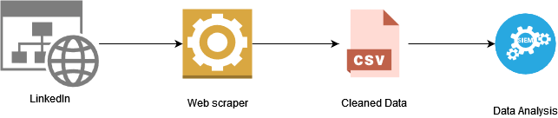


Methodology – Triangulation research methods
A local study on impact of divergent education types
Notes:
In order to apply the methodology as for the first perspective a linkedin scraper was used to gather data. Then it was extensively cleaned and analysed through different methods which are MaxQDA and Factor analysis for mixed data (FAMD) using R.
Second perspective was done by distributing surveys while the third was done through conducting one to one interviews.

Slide 9
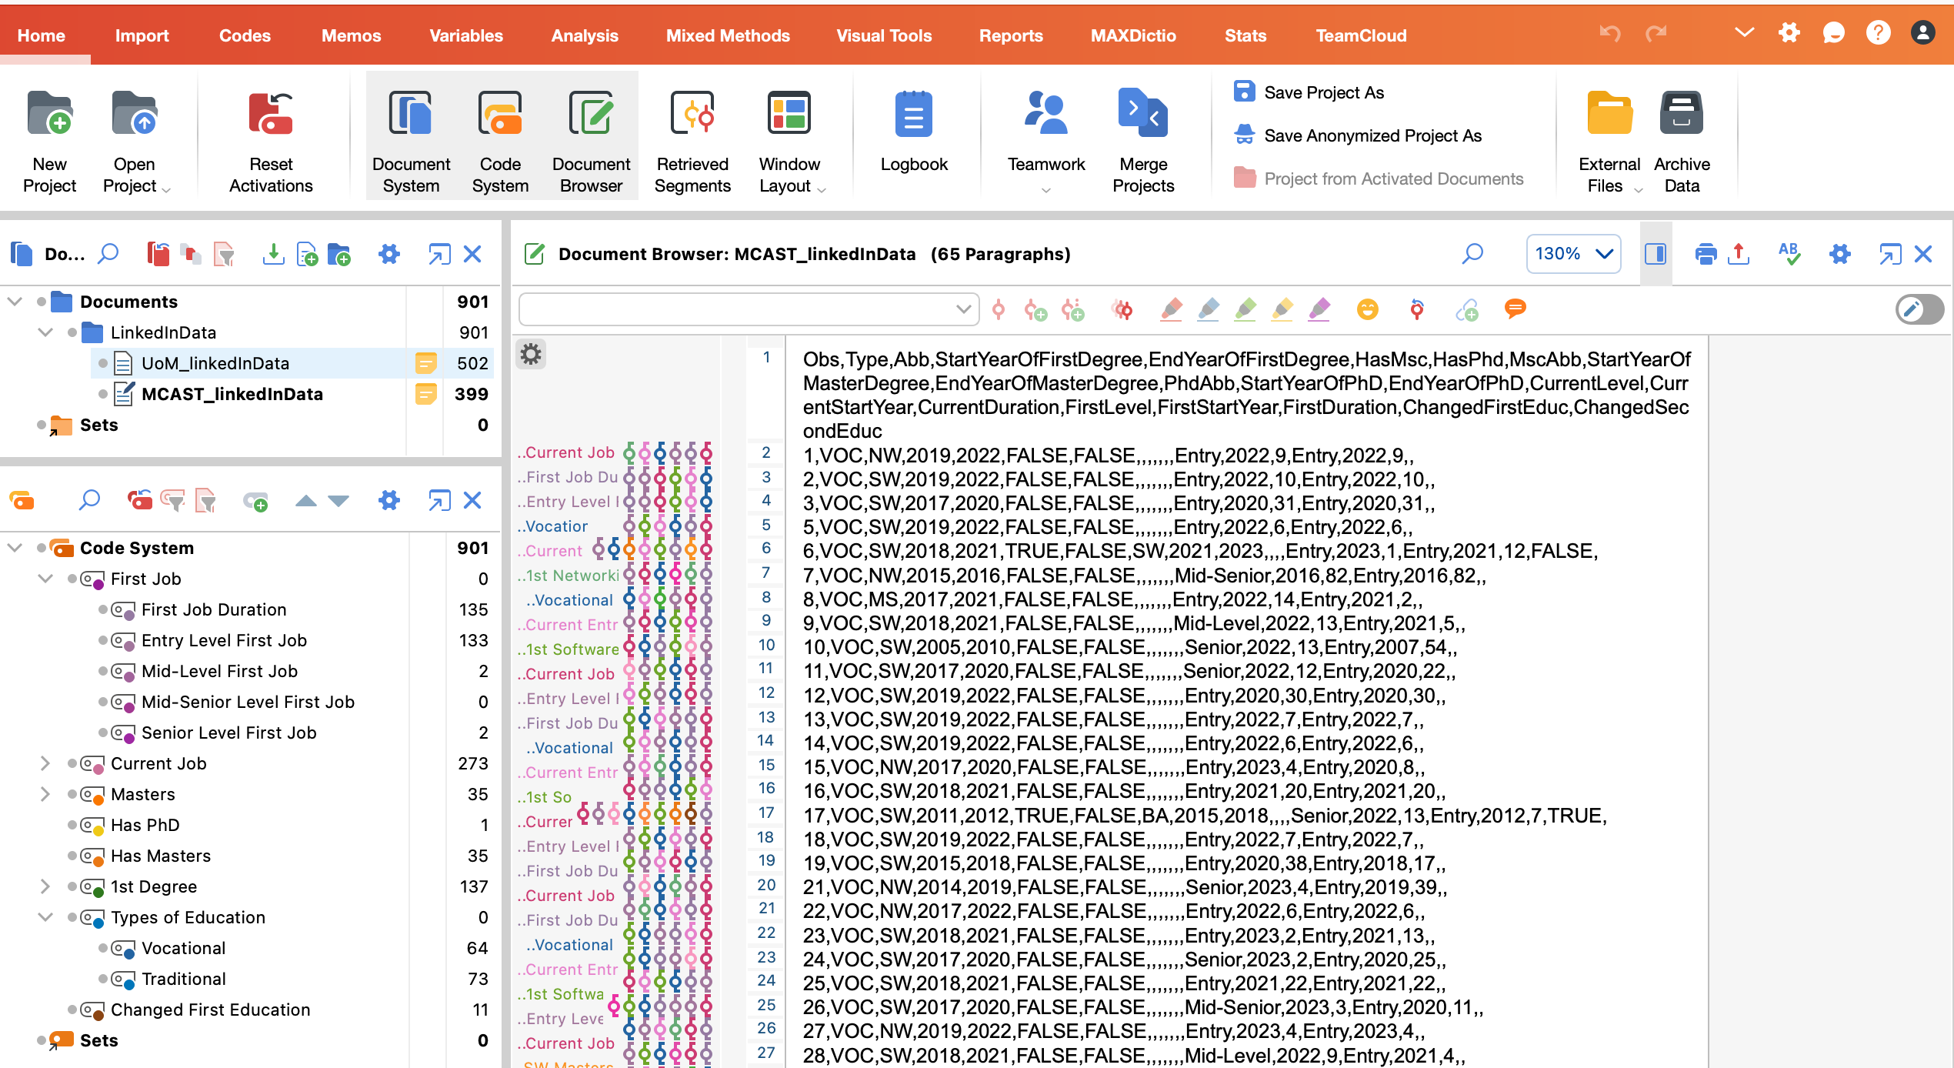
First Perspective
Profiles of 100 LinkedIn UoM graduates
Profiles of 100 LinkedIn MCAST graduates
All with current ICT jobs
Data was extensively cleaned, coded and analysed in different ways, MaxQDA & FAMD.
Initial themes were extracted in order to further analyse in subsequent viewpoints
Notes:
Going into more depth, 100 UoM and 100 MCAST profiles were scraped through linkedin and it must be noted that all of the profiles have a current ICT job.
Afterwards, as mentioned data was cleaned, analysed and initial themes were extracted.

Slide 10

Second Perspective
Two independent quantitative surveys were conducted with different cohorts.
Both surveys were sectioned into 4 different sections:
Demographic information and details about
Participants' education background
Participants’ employment background
Reflection on their experiences and perceptions
Notes:
For the second perspective we have Two independent quantitative surveys, one targeting students who are currently pursuing a qualification in the ICT field and the other survey targeted individuals who are working or have graduated within the ICT field.
It’s also important to mention that both surveys were sectioned into 4 different section:
Demographic information and details about
Participants' education background
Participants’ employment background
Reflection on their experiences and perceptions

Slide 11
Third Perspective
One-to-one qualitative interviews were conducted as the third viewpoint of data collection.
These interviews offer flexibility in research as questions can be adapted based on the participant's responses.
All interview participants were ICT professionals from diverse backgrounds and experiences.
The interviews aimed to gain insights and a deeper understanding of participants' perspectives on ICT-related topics.
Notes:
With regards to the third perspective, I have conducted 8 interviews however only 7 were transcribed due to technical issues and the main purpose of this perspective is to gain insights and a deeper understanding of participants' perspectives

Slide 12
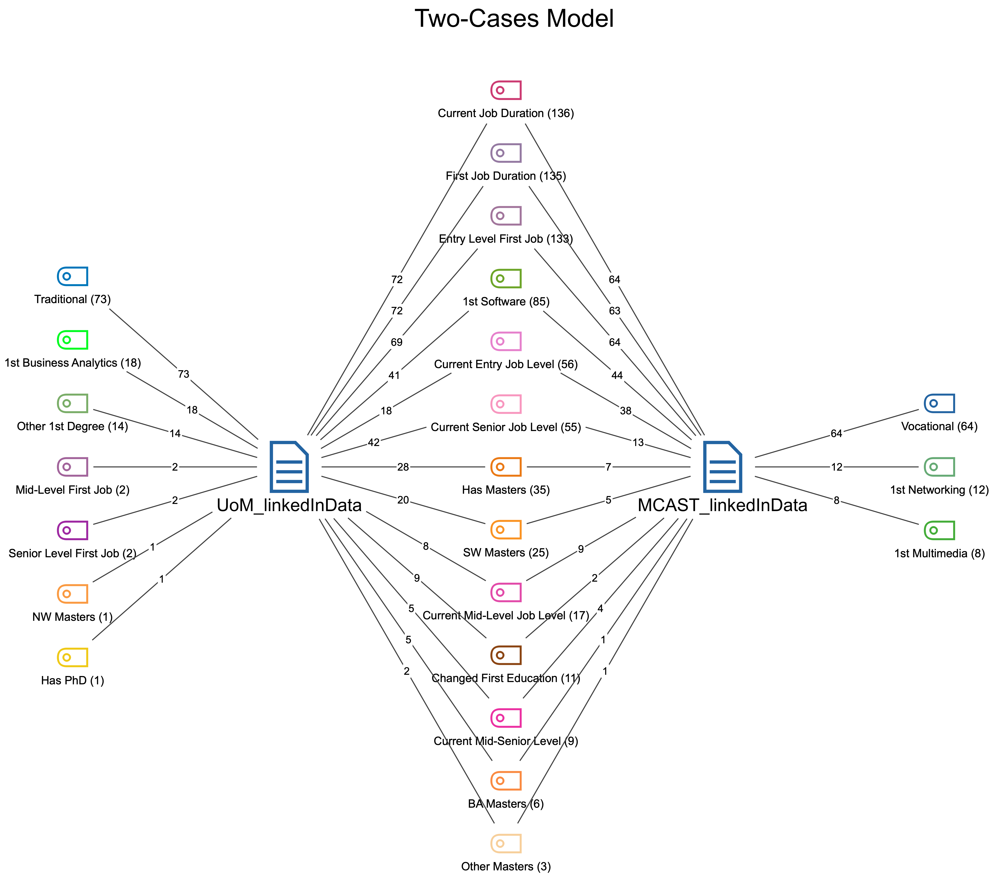
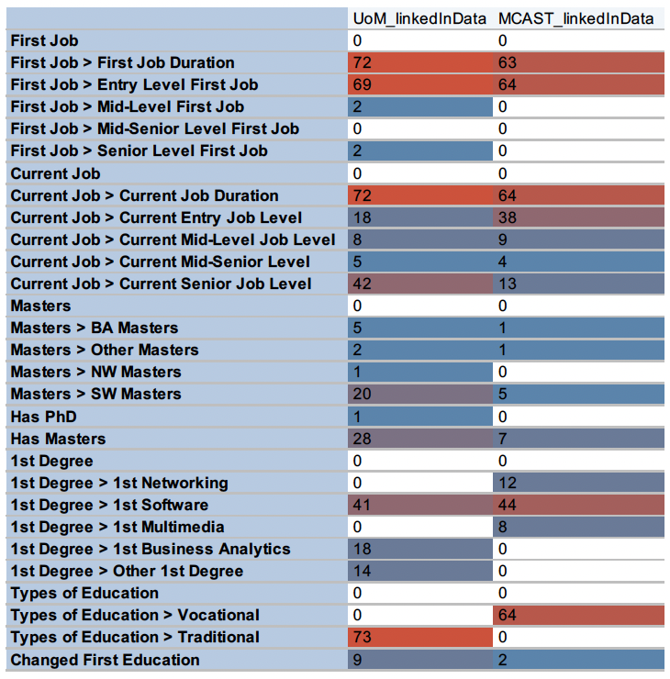
Results of the First Viewpoint
Notes:
Code Matrix and Two Case Model
From the 2 Case model we can see that
on the left there is the traditional side and its unique themes
on the right we can see vocational side
while in the middle there are commonalities such as the amounts of people having current entry level job, mid-level or senior and other aspects and also information relating to masters

Slide 13
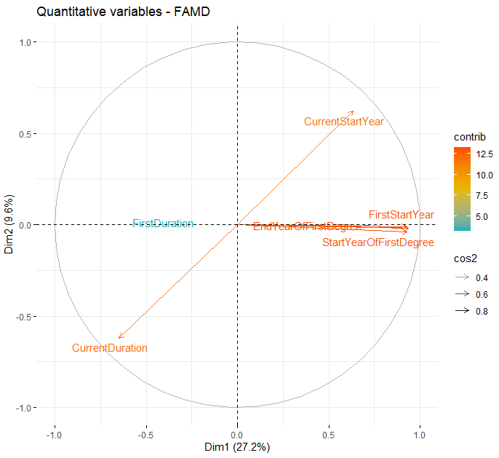
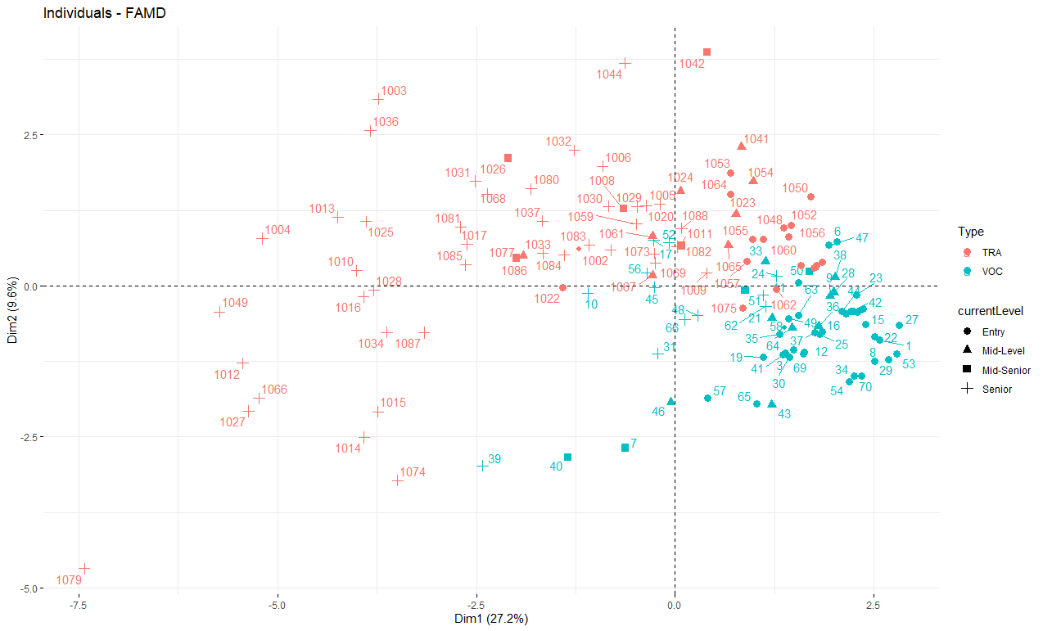
PC 1 and 2
Notes:
Here we have the FAMD results of Principal Component 1 and 2
It is important to mention that not all of the results are included in the slides due to time restrictions
From the FAMD analysis we can see that different clusters were UoM being red while MCAST being teal
This analysis represents the current level and we can see that individuals coming from a traditional approach are more likely to be seniors or higher up levels, while vocational individuals mostly attain an entry level.
This is mostly due to the fact that UoM has been established for a longer period and so the profiles scraped were of individuals who graduated earlier in time

Slide 14
Results of the Second Viewpoint
Survey Targeting Current ICT Students | Survey Targeting Current ICT Professionals
Majority of students experienced a traditional learning approach during their bachelor's degree. | Majority of participants strongly agreed that gaining practical experience while pursuing their degree was beneficial.
70% of respondents have also experienced vocational learning. | They recognized the significance of bridging the gap between theoretical knowledge gained in the classroom and real-world application.
Participants highly value vocational learning and believe it is beneficial to combine practical skills with theoretical principles. | Participants emphasized the need to apply theoretical knowledge in practical settings to enhance their understanding and skills.
Vocational learning helps individuals to be more prepared for their first position.
Notes:
Surveys Targeting Current ICT Students
Majority have undergone traditional approach during bachelor’s
However 70% have experienced vocational learning
It resulted that participants believe it is beneficial to combine practical skills with theoretical principles and that it helps in preparation for their first position
In agreement the survey targeting the current ICT Professionals
The participants also believed it is beneficial to gain practice since it bridges the gap between theoretical knowledge gained in the classroom and real-world application which therefore enhances understanding and skills

Slide 15
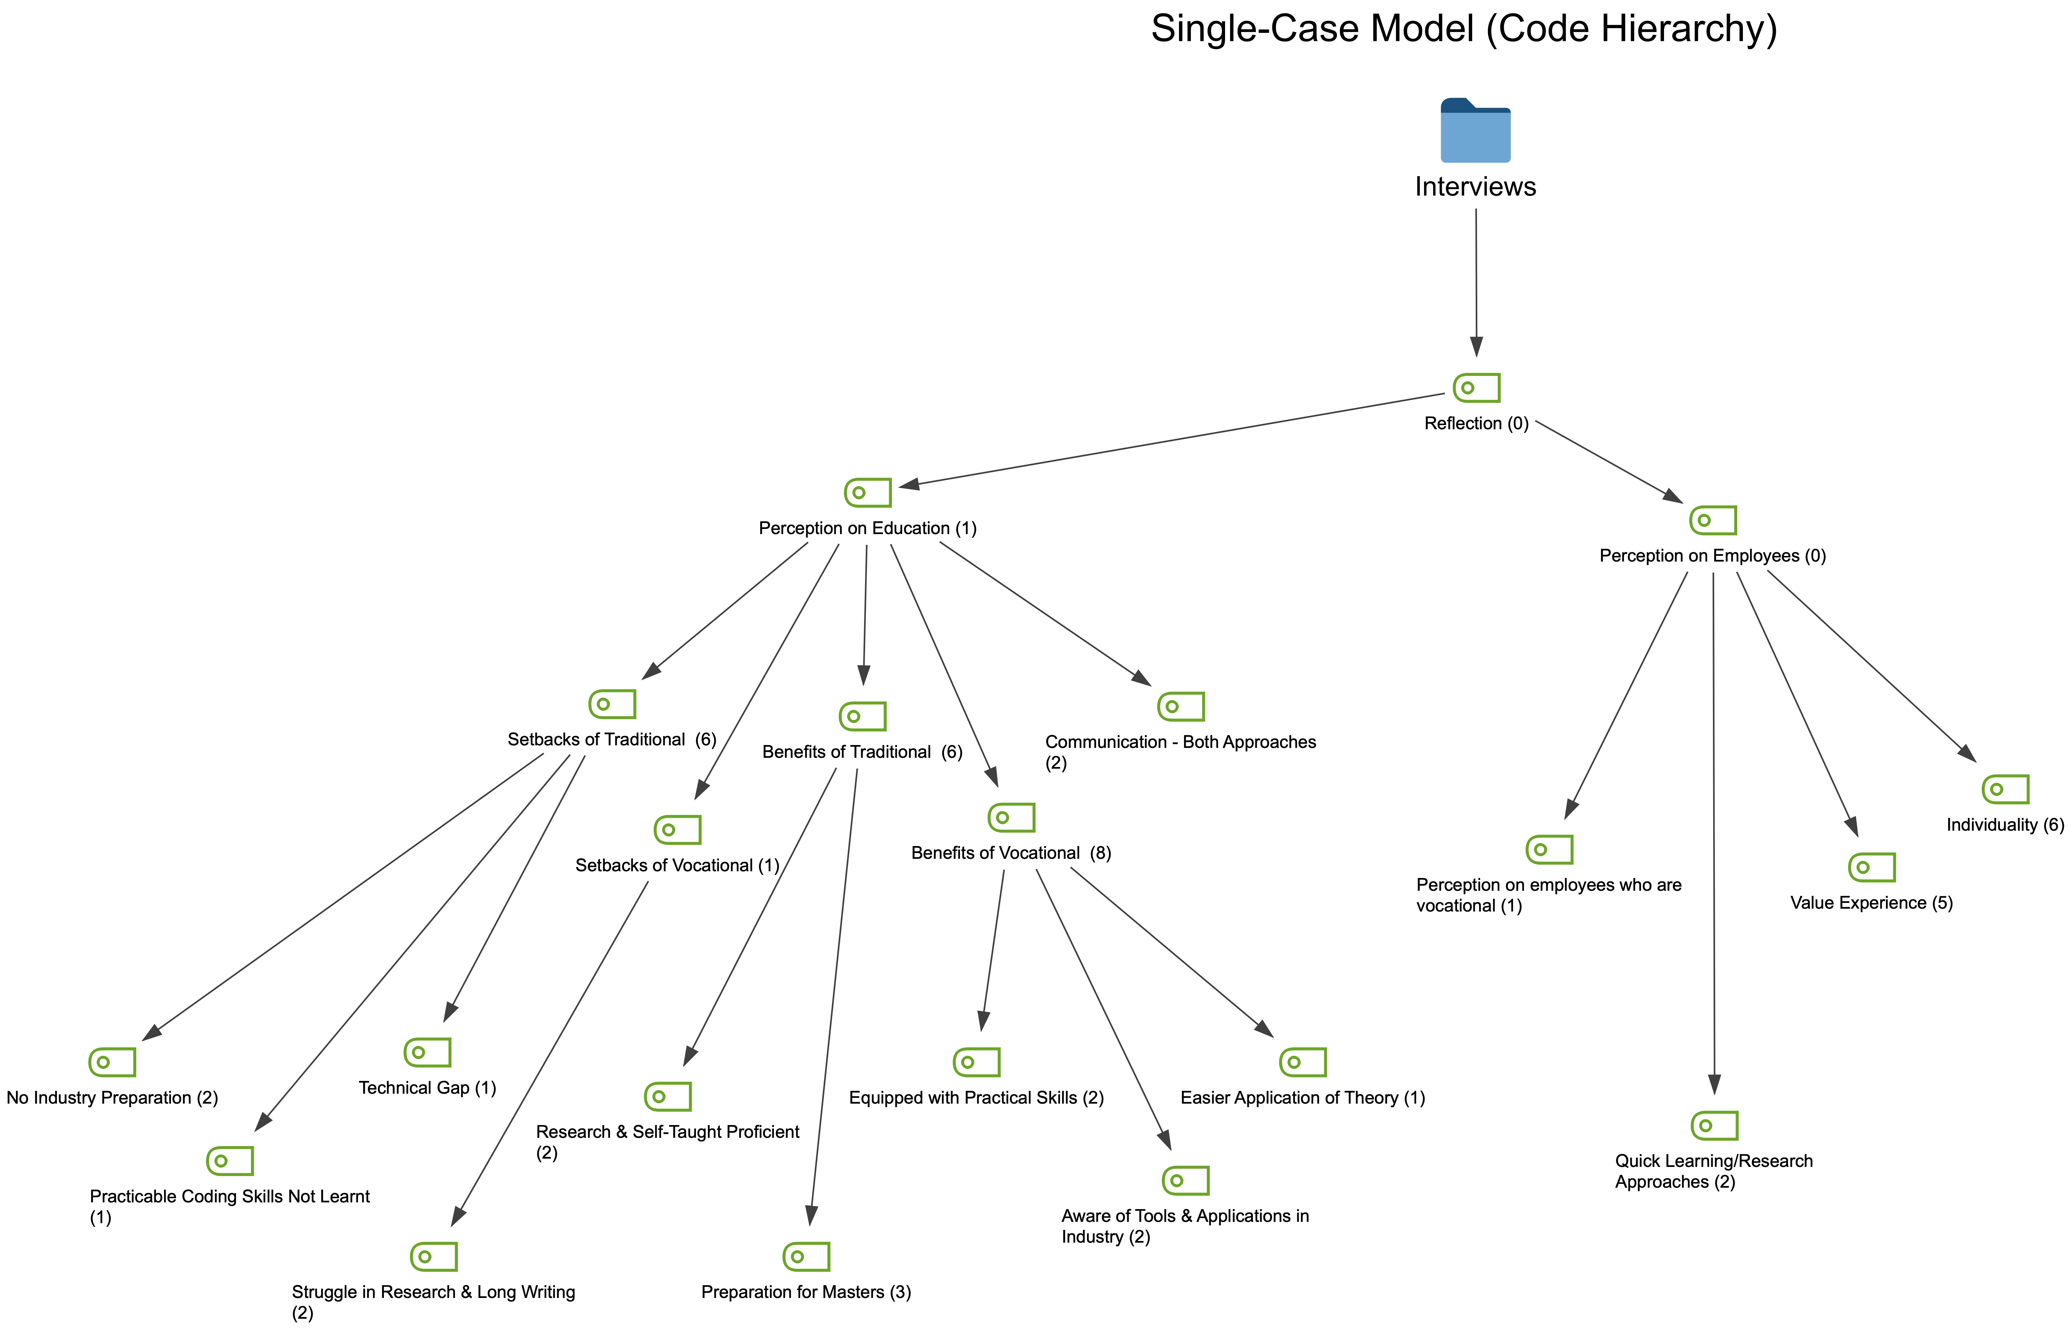
Results of Third Viewpoint
Notes:
With regards to the third viewpoint through analysis done in MaxQDA a single-case model was generated and the benefits and drawbacks of both educational styles were drawn as shown in the model.

Slide 16
Answering the Research Questions & Hypothesis
Students value practical experience and recognize the benefits of gaining practice while pursuing their first ICT degree.
Both traditional and vocational education paths are perceived positively, with UoM graduates showing a strong foundation for career growth and MCAST graduates achieving career progression and venturing into entrepreneurship.
Organisations value candidates with a vocational background for their practical skills and industry knowledge, while candidates from a traditional educational background tend to grasp new approaches and engage in research more efficiently.
The initial impact of the educational path may diminish over time as experience and career progression become more influential factors.
Notes:
Answering the Research Questions & Hypothesis
All students valued practical experience and recognised its benefits. Having said that it is important to mention that both paths are perceived positively and all graduates have the potential in achieving career progression and venturing into entrepreneurship.
When it comes to organisations, it was discovered that individuals coming from a vocational background are valued for their practical skills and smooth transition while the individuals coming from a traditional background are praised on their tendency to quickly grasp new approaches
Lastly it was also noted that the initial impact of educational paths diminished over time

Slide 17
Comparison with 3rd party papers
Methodology | Similar studies adopted for a qualitative approach by conducting interviews.
Findings | Meylan’s [2] suggestion of blended learning programs providing industry-specific skills aligns with existing research on effective educational practices and finds support in Dewey’s [3] philosophy of experiential learning. By adopting this approach, educational institutions can empower students to seamlessly transition into their preferred job occupations while fostering their overall personal and professional development.
Notes:
As mentioned when comparing to other studies a qualitative approach was conducted however this research aligns both to Meylan and John Dewey’s theory on that practice empower students to seamlessly transition into their preferred job occupations

Slide 18
Conclusions - Outcomes
Students value practical experience alongside their ICT degree.
Both educational paths are both positively perceived. Graduates have a strong foundation for career growth & entrepreneurship.
Employers value vocational education graduates for practical skills and industry knowledge.
Traditional education graduates excel in grasping new approaches and research.
Experience and career progression become more influential over time.
Notes:
To conclude the main outcomes achieved were that
Students highly value practical experience alongside their ICT degree.
Students with both backgrounds have are positively perceived and have a strong foundation for career growth & entrepreneurship
Employers value student with different backgrounds for different but both important reasons
Experience and career progression become more influential over time.

Slide 19
Conclusion - Achievements
The research successfully demonstrated the triangulation of viewpoints and employed the Factor Analysis of Mixed Data method.
The extensive sample size with regards to surveys and interviews greatly enhances the overall validity and reliability of the study.
Notes:
It also must be mentioned that the achievements of this research were that triangulation of viewpoints and implementation the Factor Analysis of Mixed Data method was successfully demonstrated and that this research was backed up with a good sample size.

Slide 20
Conclusion - Limitations
Limitations from the 1st Perspective:
Reliance on scraped data without verification, posing the risk of including inaccurate or incomplete information.
Limitation to individuals with LinkedIn profiles, introducing potential sample bias.
Data cleaning subject to human error and bias, despite efforts to ensure consistency.
Limitations in the 2nd & 3rd Viewpoint:
Online surveys based on a convenience sample, resulting in an imbalance of students from different educational backgrounds.
Exclusion of age brackets hindering direct comparison among individuals with similar demographics.
Notes:
Limitations
LinkedIn data was taken at face value
Limitation to having access to only individuals with linkedin profiles
Data cleaning was subject to human error and bias, despite efforts to ensure consistency.
There was an imbalance of students from different educational backgrounds in the online survey
The difference in age hindered direct comparisons

Slide 21

Further Recommendations
Involving Additional Traditional & Vocational Universities:
Obtain a comprehensive perspective.
Research on a larger, diverse sample.
Two Types of one-to-one Interviews:
Junior-level Individuals.
Senior-level Individuals.
Notes:
As for further recommendations it would be insightful to include other universities with the same approaches (traditional and vocational), while also conducting two types of interviews would give an additional, in-depth perspective
Junior-level Individuals:
Gather early-career perspectives.
Understand educational impact on early stages.
Senior-level Individuals:
Compare seasoned professionals' views.
Gain insights into long-term progression.

Slide 22
References
[1] Basil P Tucker and Stefan Schaltegger. Comparing the research-practice gap in management accounting: A view from professional accounting bodies in Australia and Germany. Accounting, Auditing & Accountability Journal, 2016.
[2] Christophe Meylan. What is vocational education? https://hospitalityinsights.ehl.edu/what-is-vocationaleducation#:˜:text=The%20vocational%20type%20of%20education,your%20profession%20and%20get%20started.
[3] John Dewey. Democracy and education: An introduction to the philosophy of education. Aakar Books, 1915.

